Slide 1


CypherSafe
Encryption/Decryption, Hashing & Digital Signature
Mohamed Achek Mohamed Amine Saoudi
Advisor: Prof. Manel Abdelkader Tunis Business School 18/05/2025
CypherSafe
0 / 15

Slide 2
Table of Contents
Introduction
Objectives
Methodology
Demonstration
Diagram
Results & Evaluation
Future Enhancements
CypherSafe
1 / 15

Slide 3
Introduction
Introduction
In a digital world where privacy is increasingly threatened, ensuring file security is essential.
CypherSafe is a powerful desktop application that integrates five critical security components:
Symmetric Encryption Asymmetric Encryption File Hashing
Digital Signature & Verification
Image & Video Encryption/Decryption
Why CypherSafe?
There is a lack of integrated, user-friendly, and secure encryption tools that combine all four
methods into one platform. CypherSafe addresses this gap with clarity and robustness.
CypherSafe
2 / 15

Slide 4
Objectives
Objectives
General Objective
To develop a secure and user-oriented encryption application for protecting files, ensuring integrity, and enabling verification.
Specific Objectives
Implement efficient symmetric encryption. Support asymmetric encryption.
Integrate hashing to ensure integrity
Enable digital signature creation and validation.
Focus particularly on Image & Video Encryption/Decryption
CypherSafe
3 / 15

Slide 5
Methodology
Methodology
The project is built using Python. Libraries used:
cryptography and PyCryptodome for symmetric and asymmetric encryption/decryption
hashlib for hashing.
MediaPipe for video encryption streamlit for interactive interface
Features:
Password-based symmetric key. RSA public/private key generation. File hash comparison.
Digital signature creation and verification. Image & Video Encryption/Decryption
Strong separation between the encryption layers with secure UI handling.
CypherSafe

Slide 6
Symmetric Encryption / Decryption
Demonstration
Key Mechanism
A symmetric key is derived from a user-provided password using a salt for enhanced security. The password is hashed and stretched using PBKDF2 to generate a strong key.
Algorithms Used
AES (Advanced Encryption Standard) Used for general file encryption
FERNET (from cryptography) Provides AES in CBC mode + HMAC for integrity
DES (Data Encryption Standard) Implemented for historical comparison only
CypherSafe

Slide 7
Asymmetric Encryption / Decryption
Demonstration
RSA (Rivest–Shamir–Adleman)
ECC (Elliptic Curve Cryptography)
Generates a public and private key pair. Suitable for encrypting small files.
More secure with smaller keys.
Ideal for resource-constrained environments.
CypherSafe

Slide 8
Hashing Algorithms
Demonstration
Purpose of Hashing
Hashing creates a fixed-size digital fingerprint of data. Used to verify file integrity and detect tampering.
Algorithms Used
SHA-512 Strong cryptographic hash with 512-bit output
SHA-256 Widely used secure hash with 256-bit output
MD5 Fast but insecure; used here for educational contrast
CypherSafe

Slide 9

Digital Signature
Demonstration
Digital Signature Process in CypherSafe:
A file’s hash is first generated using SHA-256.
This hash is then encrypted using the sender’s private key (RSA or ECC).
The recipient decrypts the signature using the public key.
The file is hashed again and compared to verify integrity and authenticity.
Why use Digital Signatures?
Authentication. Integrity.
Non Repudiation.
CypherSafe

Slide 10
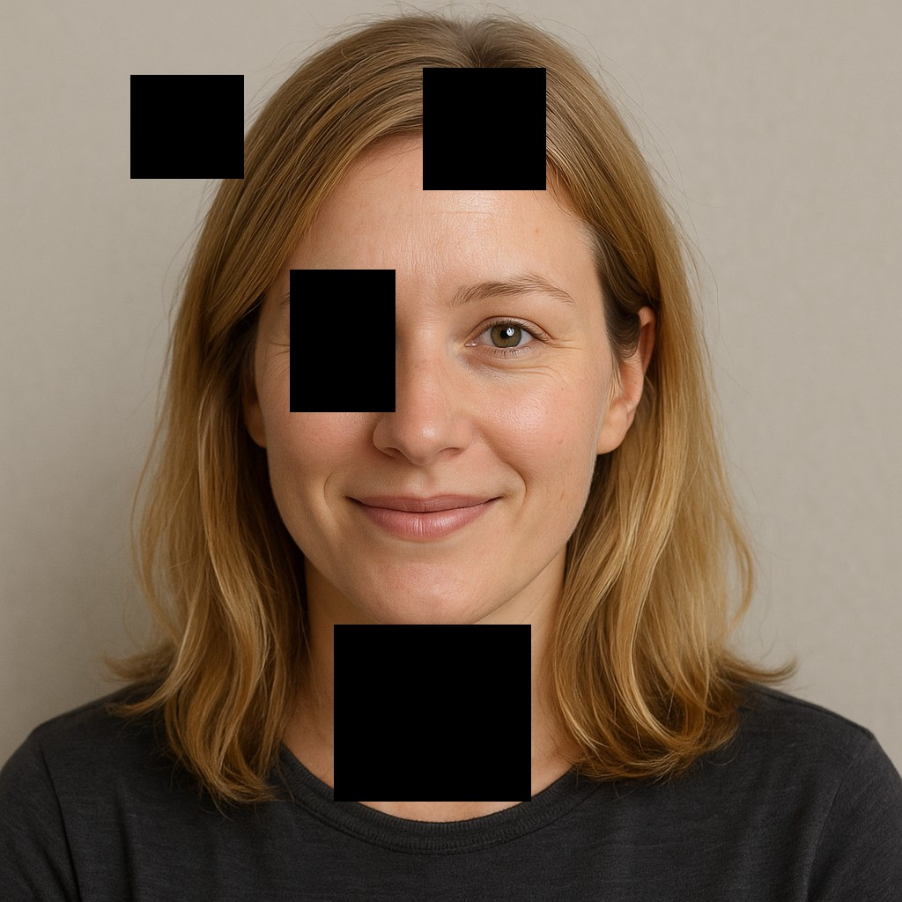
Image Encryption
Demonstration
Partial Image Encryption with AES:
Partial encryption applied to images using AES AES . Selected portions (e.g., top half or edges) are encrypted.
Keeps a ”visually scrambled” look — secure yet human-visible.
CypherSafe

Slide 11

Demonstration
Video Encryption – AI Face Hiding
CypherSafe

Slide 12
Main Project and Tackled Sub-Projects
Demonstration
Main Project: Project 11 – File Encryption/Decryption
This is the core project we have been developing. It involves:
Combining symmetric (AES) and asymmetric (RSA, ECC) encryption. Ensuring file confidentiality, integrity, and authenticity.
Providing an interactive, user-friendly encryption platform.
Sub-Projects Tackled Alongside
To fully realize Project 11, we tackled additional mini-projects, including:
Project 1 – Text Encryption/Decryption: Securing text content using both symmetric & asymmetric Encryption/Decryption.
Project 3 – Image Encryption: Partially encrypting images using AES for visual security.
Project 4 – Password Strength: Implementing a password strength evaluation mechanism.
Project 5 – Web-Based Facial Authentication System: Implementing face recognition through a webcam for secure user authentication.
CypherSafe

Slide 13
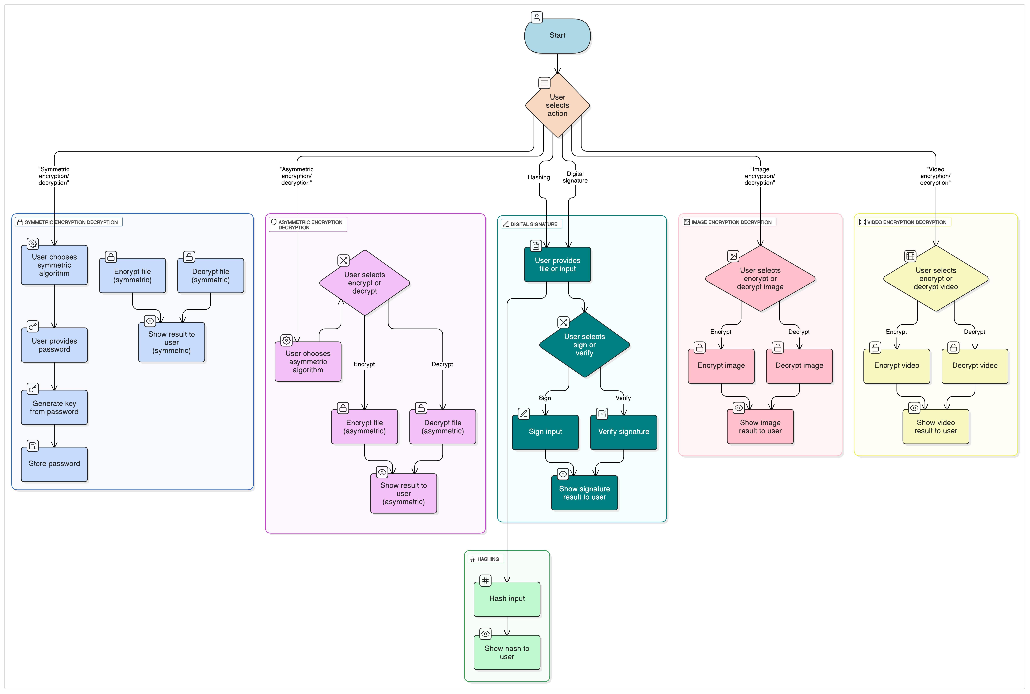
Diagram
Diagram
CypherSafe

Slide 14
Results & Evaluation
Results & Evaluation
Robustness: CypherSafe successfully encrypted and decrypted files of various formats (.txt,
.png, .mp4...) without data loss or corruption.
Integrity Validation: Hashing algorithms (SHA-256, SHA-512, MD5) correctly detected file alterations and confirmed file authenticity.
Digital Signature Accuracy: The signing and verification process using RSA keys accurately validated document origin and detected tampering.
Performance: The application showed fast and stable behavior across encryption methods, even with large files and multiple operations.
CypherSafe

Slide 15
Future Enhancements
Future Enhancements
Cloud Integration: Enable secure upload/download of encrypted files from trusted cloud platforms (e.g., Google Drive, Dropbox).
Access Logs & Monitoring: Implement detailed logging to track file access and user activity for enhanced auditability.
Mobile Support: Develop an Android/iOS version to extend secure file encryption on mobile devices.
These upgrades aim to make CypherSafe more accessible, scalable, and secure across platforms.
CypherSafe

Slide 16

Future Enhancements
Thank you for your attention !
CypherSafe

